Slide 1

Domain 2: Design Resilient Architectures
26%

Slide 2
What does it mean to “Design Resilient Architecture”?
The capability to recover when stressed by load (more requests for service), attacks (either accidental through a bug, or deliberate through intention), and failure of any component in the workload’s components.
I.E if one part of your architecture has problems or vulnerabilities the rest should not be adversely affected.

Slide 3
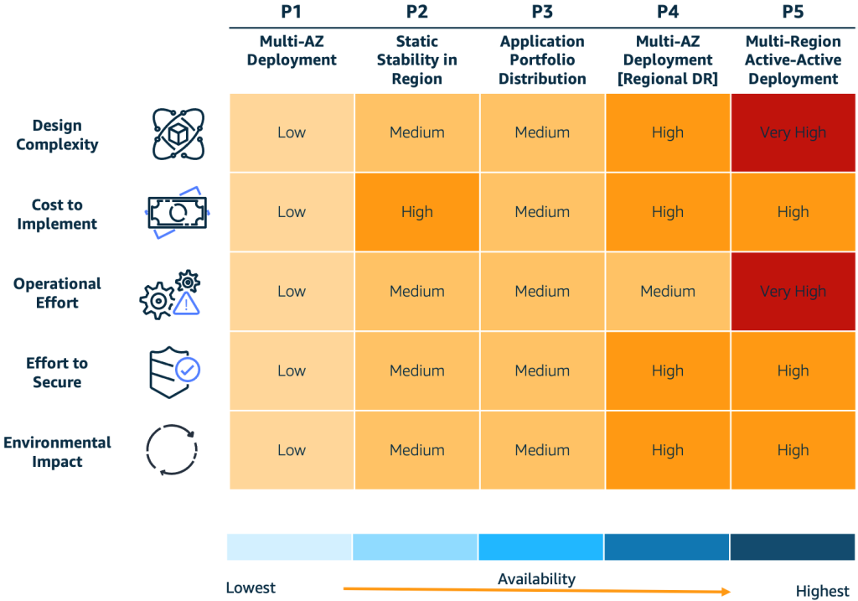

Slide 4
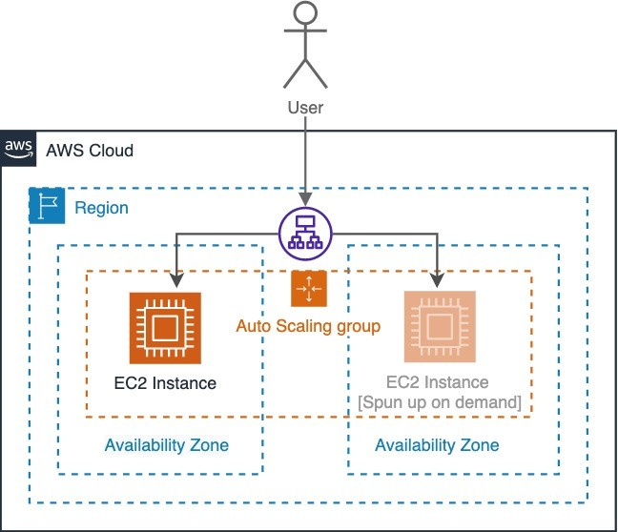
Pattern 1 - Multi-AZ
Allows your application to withstand AZ-level impacts
Mitigates a disruption to the AZ hosting the application, but comes at the expense of application recovery
End users’ access to the application while the new resources are being re-provisioned in a new AZ
Great for low-business-impact apps
AKA bi-modal behavior

Slide 5
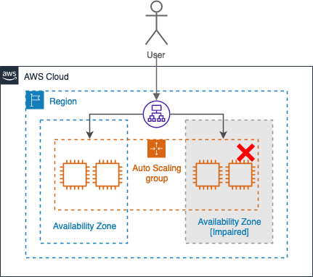
Pattern 2 - Multi-AZ w/ Static Stability
Uses multiple instances across multiple AZs within a Region to increase resilience.
Uses two EC2 instances that are provisioned within two AZs. When the AZ becomes impaired, the website continues to operate as the Elastic Load Balancer diverts traffic away from the impacted AZ.
Uses static stability to prevent bimodal behavior
Statically stable systems remain in one mode despite changes, reducing complexity during recovery
P2 is applied to a customer-facing website with a lower tolerance for downtime.

Slide 6
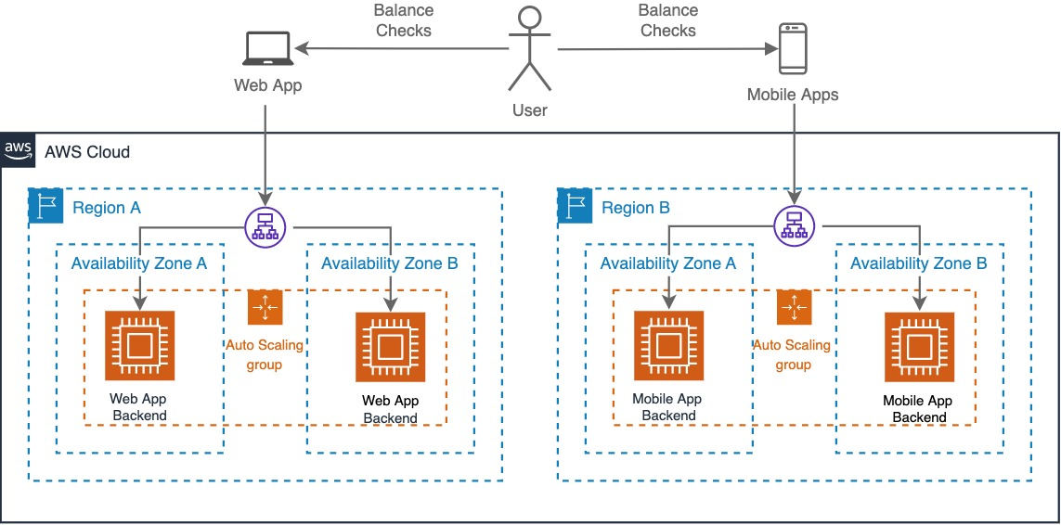
Multi-Region pattern to increase functional resilience
Customers can still access services deployed in an alternate Region
Regional service disruptions are very rare
Requires significant operational planning and management
Pattern 3 - Application portfolio distribution

Slide 7
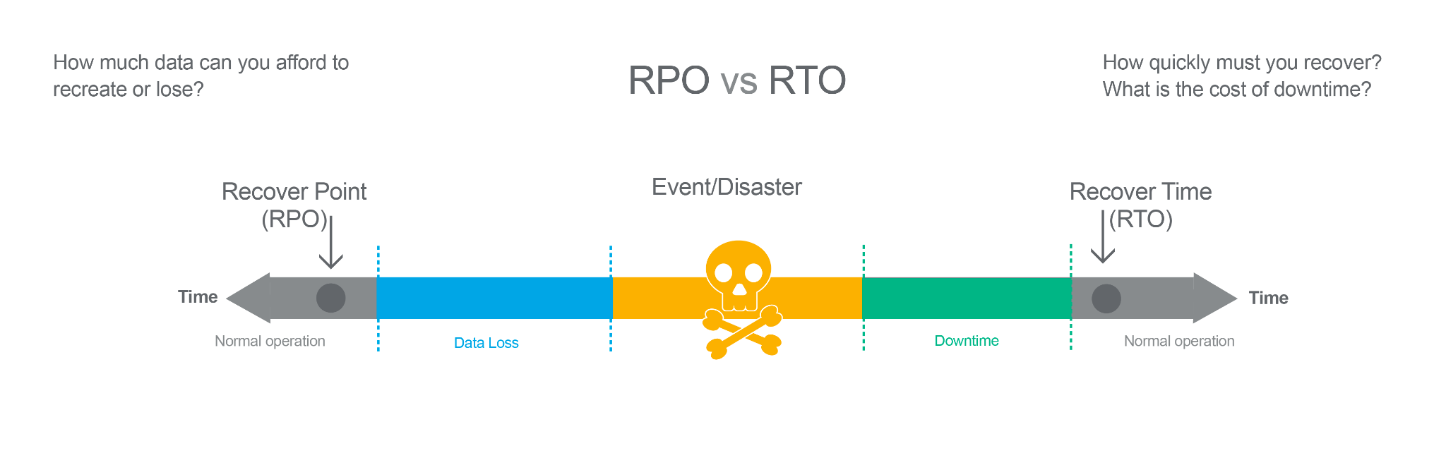
Pattern 4 (P4): Multi-AZ deployment (multi-Region DR)
Pilot Light – Works for applications that require RTO/RPO of 10s of minutes. Data is actively replicated and app infra is pre-provisioned in the DR Region. App infra is kept switched-off and only switched-on during the restore event.
Warm Standby – Improves restore times significantly compared with pilot light by keeping your applications running in the DR Region but with a reduced capacity. App infra will be scaled up during a DR event, but can typically be automated with minimal manual effort. This pattern can achieve RTO/RPO of minutes if implemented correctly.

Slide 8
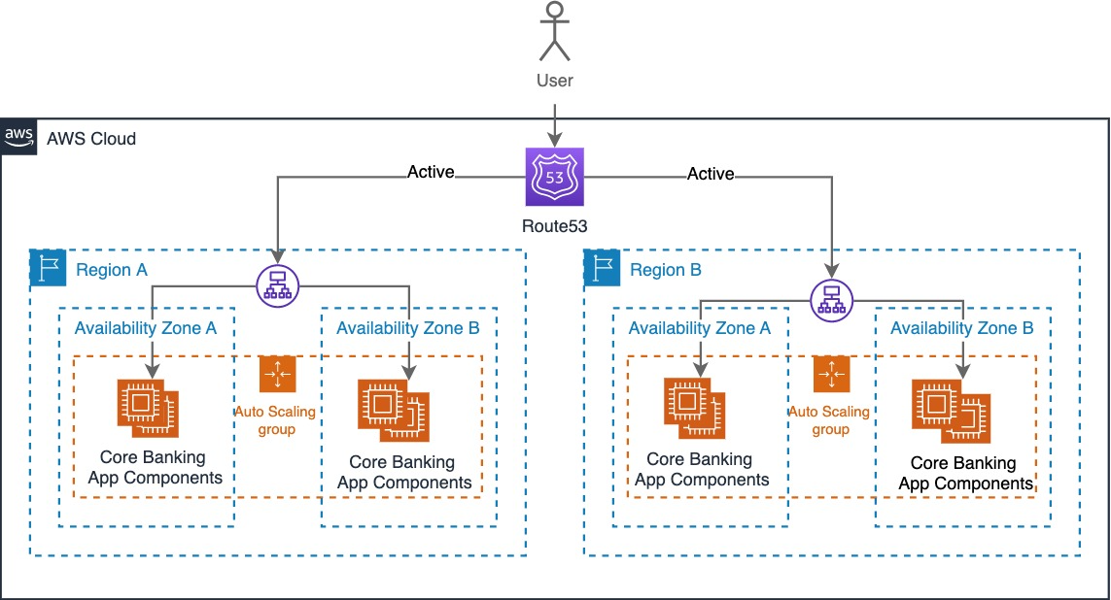
Applications with zero tolerance for disruption
Run their workload simultaneously in multiple Regions
Mitigates against regional disruptions
Invests additional costs and complexity to deliver a RTO of near zero and an RPO of near zero data loss
Pattern 5 - Multi-Region active-active

Slide 9
Hands-on Demo
Pattern 1

